Slide 1
Build your network with CANP
Enhance Your
Career

Slide 2
Mission, Strategic Pillars & Core Values
Framework of CANP’s Success
Strategic Pillars
Mission
Core Values
CANP is the unifying voice and networking forum for NPs providing expert guidance and advancing the NP profession statewide.
CANP will support NPs as they meet the needs of all patients by providing high-quality care to diverse communities.
Integrity
Compassion
Respect
Accountability
Collaboration
Inclusivity
Innovation

Slide 3
Who We Are
A Unifying Voice for Nurse Practitioners
4,800+
NPs, students, and business leaders
40+
Years engaged in the legislative process
Only association solely advocating for NPs in California
“CANP membership can open so many doors for you as a new NP.”
Cynthia Jovanov, Immediate Past President
Protecting your practice, one legislative policy at a time

Slide 4
The CANP Experience
Connect, Advocate, Learn and Celebrate
Community
Advocacy
Opportunity
Add to CANP’s collective voice at the State Capitol as we promote the vital role that NPs play
Find inspiration from a supportive network of NP peers
Access to events, educational programs, practice & legal advice and professional discounts

Slide 5
Power in Practice

Slide 6
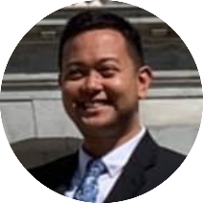
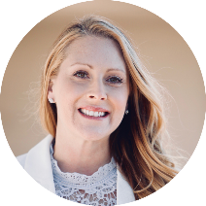
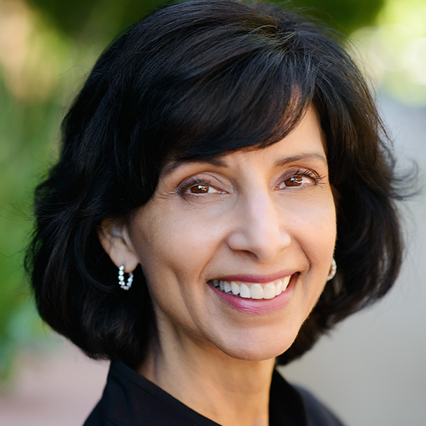
Board of Directors
Meet the Leaders
Vice President, Finance John Aldrich Alejandro | Immediate Past President Cynthia Jovanov | President Aimee Paulson | President Elect Surani Hayre-Kwan | Vice President, Corporate Affairs Tiffany Nielsen
Notes:
Founded in October 1977 as the California Coalition of Nurse Practitioners by a small group of NPs from the University of California, Davis
Has grown over the last 45 years to California Association for Nurse Practitioners, representing more than 4,000 NPs, students, and business leaders and providing leadership opportunities for NPs across the state

Slide 7
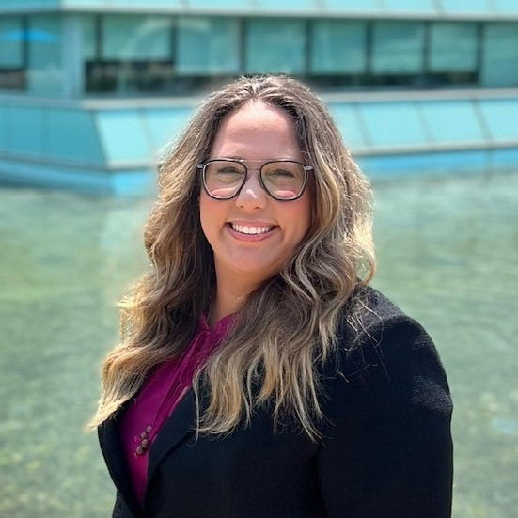
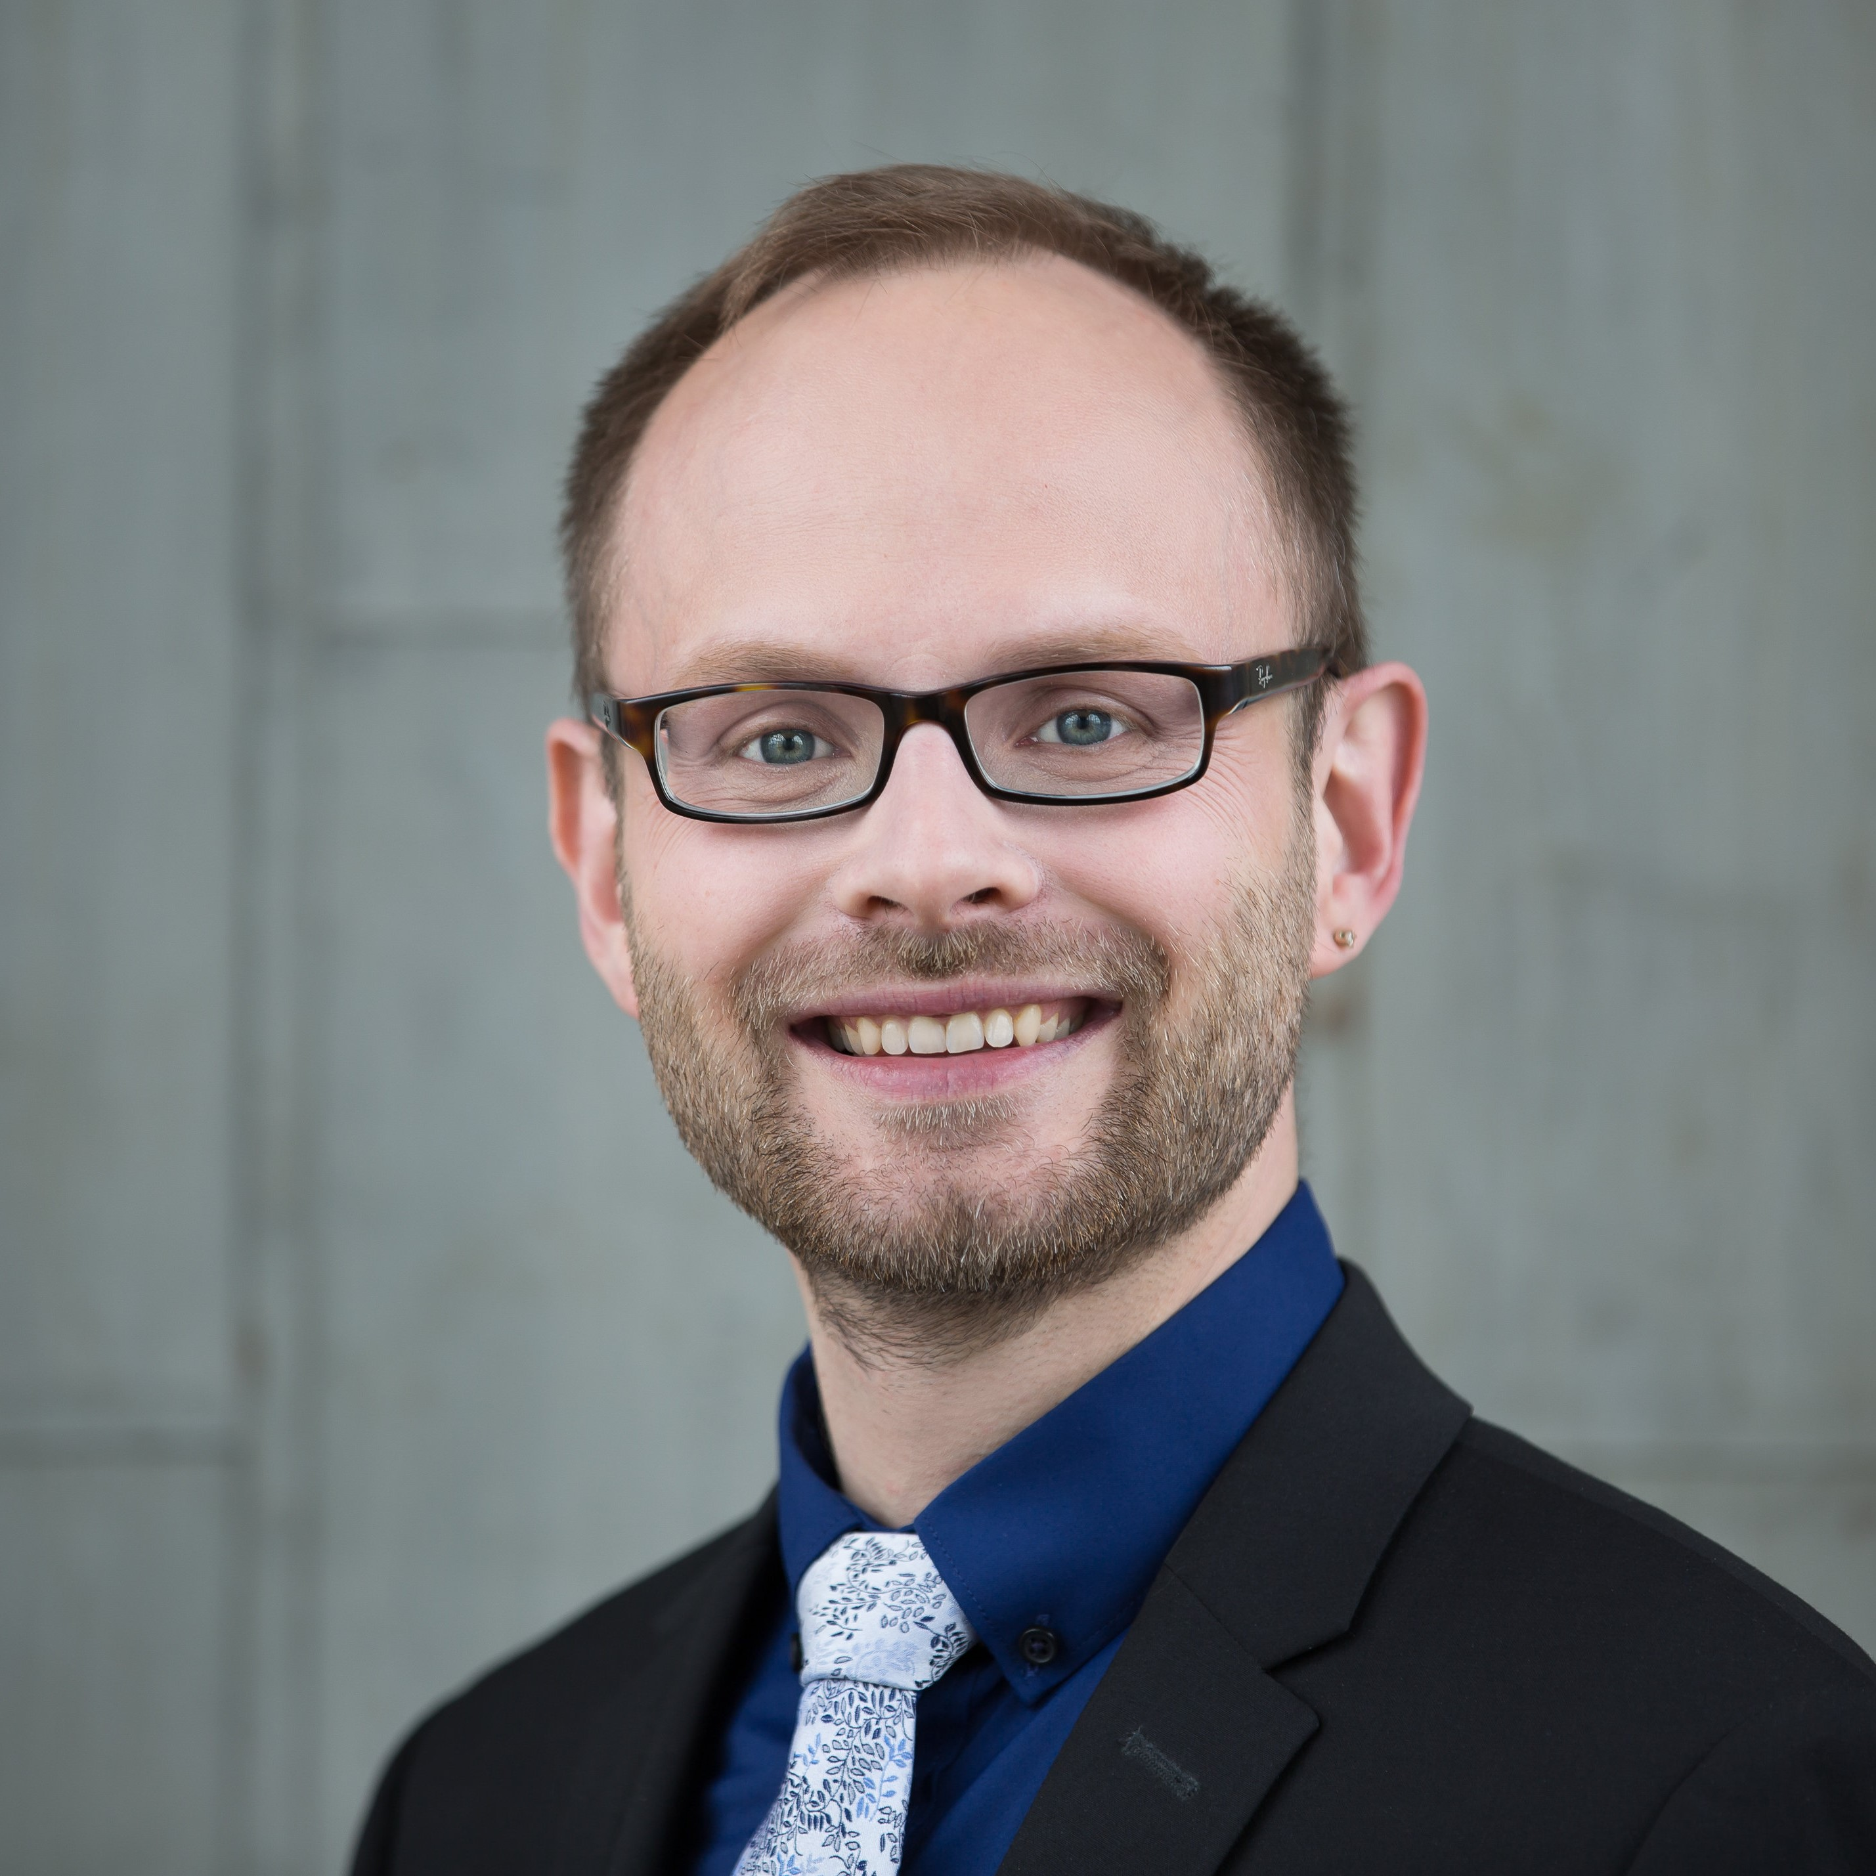
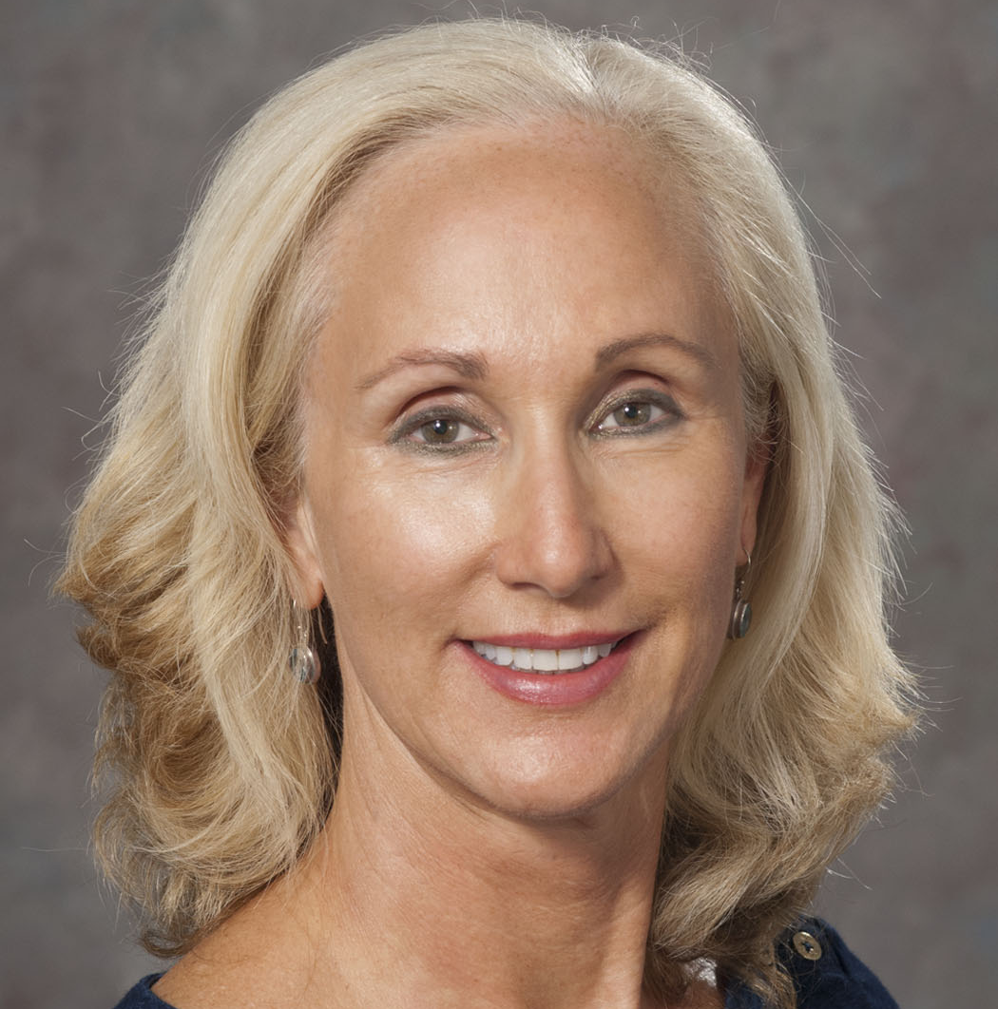
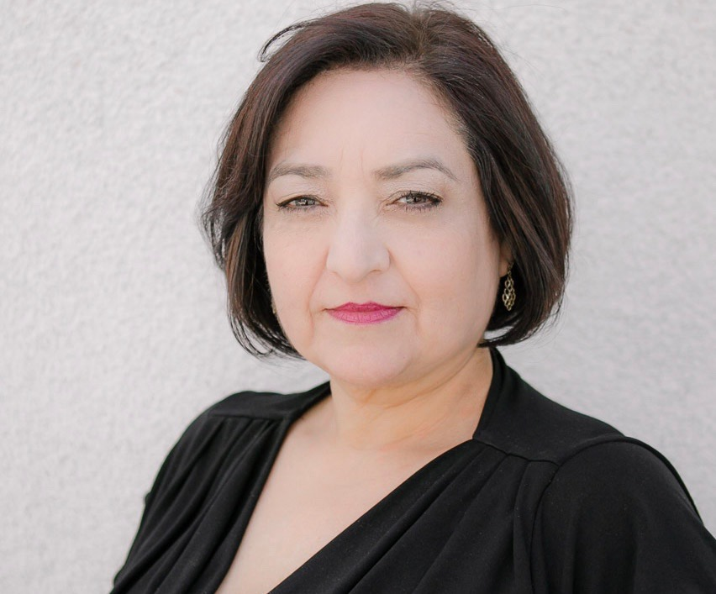
Board of Directors
Meet the Leaders
Health Policy & Practice Co-Chair Adrienne Marks | Health Policy & Practice Co-Chair Ron Ordona | Membership Chair Rhonda Infante | Educational Affairs Co-Chair Lars Gjerde | Educational Affairs Co-Chair Holly Kirkland-Kyhn | Health Justice Chair Cynthia Sanchez

Slide 8
Legislative Action
Making a Difference
SB 544
Permit NPs and PAs the authority to prescribe medication for opioid addiction treatment
2013
2019
CANP has been a champion for NPs and their ability to practice to the full extent of their education and training for more than 40 years
SB 352
NPs and PAs are permitted to supervise medical assistants in all practice settings
AB 1514
Authorize NPs to certify the needs of an individual diagnosed as deaf or hard of hearing
2017
Notes:
Examples of historical legislative action that CANP was involved in. CANP has been the champion for NPs and their ability to practice within their full medical training.

Slide 9
AB 890 Signed Into Law
Making a Difference
In 2020, CANP and its members achieved a monumental victory with the passage of AB 890. After a decade of legislative advocacy, California NPs now have the ability to practice without physician supervision.
This success would not have occurred without the strong leadership of an organization focused solely on promoting the important work of NPs like you.
Notes:
CANP was instrumental in passing AB 890, which allows NPs to work without physician supervision. CANP led a coalition of 80+ organizations in supporting and advocating for the bill through the legislative process and in the Governor’s office.
CANP is continuing to advocate for nurse practitioner independence through the AB 890 regulatory process, which is ongoing.

Slide 10
Health Justice Committee
Bridge Gaps in Health Care with Inclusivity
CANP commits to align with anti-racism and social justice tenets in support of nurse practitioners as they bridge the gaps in health care and meet the needs of their patients.
Notes:
In addition to major legislative wins, CANP is also working to advance health justice…
Health Justice Committee was established in 2021 to bring awareness to health justice issues.
For more information visit the Health Justice Resources page on the CANP website.

Slide 11
Membership & Benefits

Slide 12
Invest in You
Key Member Benefits for Students and New Grads
Statewide and Local Networking
Free Practice & Legal Advice
Outstanding Educational Opportunities
CANP Career Center
Local chapter meetings and events with exclusive opportunities to learn and network
Get timely answers from experts to your practice and legal questions
CANP empowers its members with valuable educational resources that help them stay informed
Get leads on great jobs with competitive salaries through the CANP Career Center

Slide 13
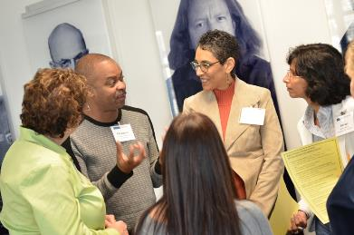
Chapter Meetings / Events
Get Connected
Network with other nurse practitioners
Learn about the latest industry information
21 active chapters throughout the state
Serve your community
Notes:
Chapter events: discuss previous and upcoming events for your chapter
Community involvement: discuss previous and upcoming events

Slide 14
Lobby Day
Invest One Day, Advocate for Your Future
Lobby Day 2024
May 7, 2024
Notes:
Every year CANP shows its strength at the State Capitol by bringing NPs face-to-face with legislators. Join your colleagues in Sacramento for Lobby Day to learn about the coming year’s legislative issues and meet with legislators to help advance CANP’s agenda. This annual event is always exciting and inspirational, leaving nurse practitioner participants empowered to continue the conversation at the local level.

Slide 15
Annual Educational Conference
Learn Alongside Your NP Colleagues
47th Annual Educational Conference
March 19-22, 2025
Westin Rancho Mirage Golf Resort & Spa
Network with peers, over 600 attendees
Largest gathering of NPs on the West Coast
Learn from industry leaders and earn 20+ hours of CEs
Notes:
Discounted member student rate, one day passes available too
Networking opportunities
Education, 20+ CEs

Slide 16
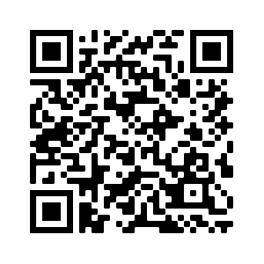
Join Us
Start Your Career Right
Save $15 with promo code STUDENT15
YEARLY
QUARTERLY
$125
$31.25
Once a year payment
Four auto-payments a year
Start Today
Start Today
Notes:
Two payment options available for first year, second year, and first year graduate students. Students who join at the annual rate get $15 off with promo code STUDENT15 on the first page of the online application.

Slide 17
Questions?
Follow Us
@CaliforniaNP
@CaliforniaNPs
@CaliforniaNP
linkedin.com/ company/canp
canpweb.org
1415 L Street, Suite 1000
Sacramento, CA 95814
(916) 441-1361
admin@canpweb.org

