Slide 1
Demystifying Pain Management: A Case-based Workshop
Theresa Mallick-Searle, MS, RN-BC, APN-BC
Mechele Fillman, MSN, NP-BC
Division Pain Medicine - Stanford Health Care

Slide 2
Disclosures
Theresa Mallick-Searle: Speaker’s Bureau for Allergan and Depomed Pharmaceuticals.
Mechele Fillman: No Disclosures.

Slide 3
Learning Objectives
Explore the pathophysiology of pain, defining acute versus chronic.
Discuss multimodal management.
Experience role playing and problem solving through complex pain management case studies.

Slide 4
What is Pain?
“Pain is a complicated process that involves an intricate interplay of chemicals and signaling in the central nervous system.” Sean Mackey, MD
“An unpleasant sensory or emotional experience associated with actual or potential tissue damage or described in terms of such damage.” IASP
“Whatever the experiencing person says it is, existing whenever he/she says it does.” McCaffery, RN

Slide 5
Institute of Medicine Report
Chronic pain affects 100 millions US adults.
#1 Reason people are out of work.
It is the leading reason that people seek
medical attention, costing the nation
upwards of $635 billion annually –
more than heart disease, cancer, &
diabetes combined.

Slide 7
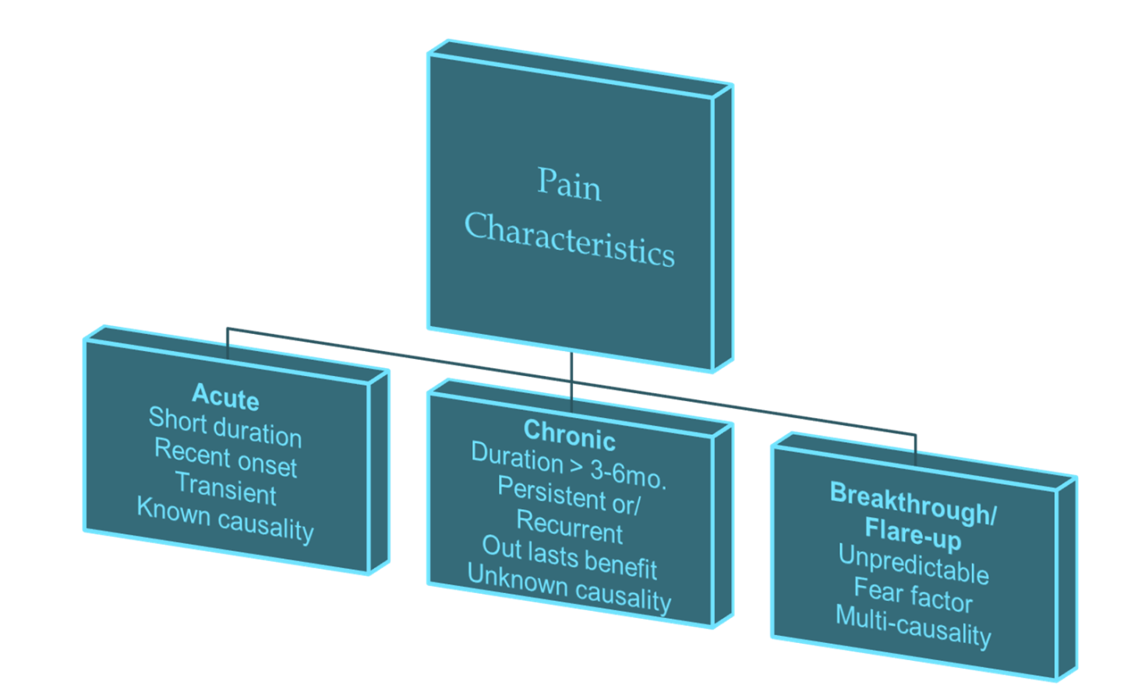
Basic Concepts

Slide 8
Acute Pain
Normal predicted physiological
response to an adverse chemical, thermal, or mechanical stimulus and is associated with surgery,
trauma, and acute illness.
It is time limited and is generally responsive to opioid therapy among other therapies.

Slide 9
Chronic Pain
A pain state which is persistent
and in which the cause of the pain
cannot be removed or otherwise
treated.
Chronic pain may be associated with a long-term incurable or intractable medical condition or disease.
Impacts emotions, relationships, QOL.

Slide 10
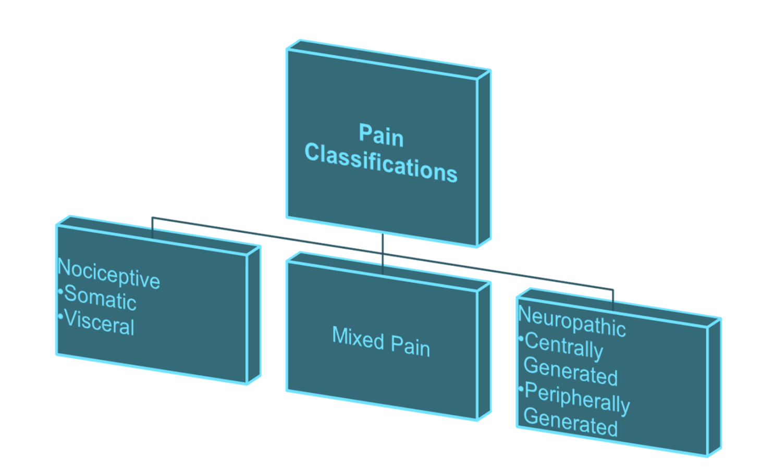
Basic Concepts

Slide 11
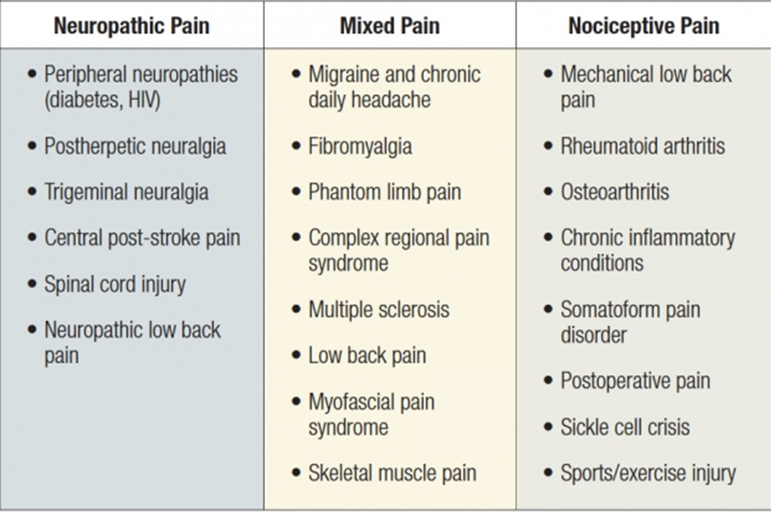

Slide 12
Goals of pain management
Identify and address the cause of pain.
Explore “the meaning” of the patient’s pain
The meaning – in turn – determines the patient’s experience.
Treat acute pain aggressively; prevent chronic.
Treat chronic pain systematically/thoroughly.
Maintain alertness and function; minimize side effects.
Improve quality of life, decrease suffering.
Intervene as minimally invasively as possible.

Slide 13
Pain Assessment
Ask about pain regularly, assess systematically.
Believe the patient and family in their reports of pain and what relieves it.
Choose pain control options appropriate for the patient, family and setting.
Deliver intervention in a timely, logical and coordinated fashion.
Empower patients and their families.
Enable them to control their course to the greatest extent possible.

Slide 14
Pain Assessment
The Meaning of pain
“There is something terribly wrong with me!” “This has to be cancer or something.”
Sinister meaning
“I can’t work, I can’t support my family, I’m completely useless.”
Self esteem/self worth
“This pain is annoying.” “I’m not going to let this pain keep me from doing what I need to do.”
Strong locus of control/resilience
“This must be a punishment for something that I did.” “Nobody could live with pain like this.”
Guilt/self loathing

Slide 15
What to assess?
Location
Quality, character, radiation
Onset, duration, variation & patterns
Alleviating & exacerbating factors
Effects of pain on activity
Present pain management regimen &
effectiveness
Pain management hx including pharmacotherapy
Pain scales are generally not useful.
Meaning, activity, disability
Presence of common barriers to pain reporting

Slide 17
Challenges in Assessment & Management
When the patient is medically complicated
Language barriers
Fear, knowledge, expectations
When there is prior exposure to opioids, benzodiazepines, muscle relaxants, etc.
When there is a substance abuse history
When the patient has chronic pain
When the patient displays a “difficult” personality
When the family is difficult or challenging

Slide 18
Interdisciplinary Care in Pain Management
The concept of interdisciplinary care refers to a philosophy and process of care that integrates the specialized knowledge of multiple disciplines:
Medicine
Nursing
Physical Therapy
Nutritionists
Pharmacists
Social Workers
Psychologist/Psychiatrist

Slide 19
PAIN
Medications
Opioids
NSAIDs/Tylenol
Topical Analgesics
Antineuropathics
Antidepressants
Muscle relaxants
Complementary
Modalities
Acupuncture
Acupressure
Massage
PT/OT
TENS
Heat/Cold
Behavioral
Modification
Psychotherapy
Art Therapy
Biofeedback
Meditation/CBT
Distraction
Interventions
Steroid Injections
IV Infusions
Trigger point Injections
Spinal cord Stimulator
IT infusions

Slide 20
Pharmacotherapy
www.mayoclinic.com
Drugs & Supplements : Excellent website on most of the medications mentioned today with dosing consideration, geriatric/pediatric parameters, side effects, etc.

Slide 21
Opioid Analgesics
“Gold Standard” pain
relief.
Orally, rectally, IM, IV, IT, epidural, transdermal.
Extended release & Immediate release formulations.
Naturally occurring or
synthetic.

Slide 22
Mechanism of Action
Opioids have affinity many different receptors, including the 5 opioid receptors: mu, kappa, sigma, delta & epsilon.
Modify the transmission of painful signals, diminishing pain perception.
Additionally, opioids work in the lim-bic system, altering emotional response to pain.
Each opioid has different affinities for different people, so patients may have different responses to different opioids.

Slide 23
Long-term side effects
Neurologic Gastrointestinal
Delirium Nausea and vomiting
Hallucination Constipation
Sedation Obstruction common bile duct
Myoclonus Gastroesophageal reflux disease
Hyperalgesia
Muscle rigidity
Seizures Urologic
Headaches Altered kidney function
Urinary retention
Cardiopulmonary Peripheral edema
Respiratory depression
Pulmonary edema Endocrine
Bradycardia Osteoporosis
Hypotension Hypogonadism/sexual dysfunction
Cardiac dysrhythmias
Dermatologic Other
Pruritus Opioid induced hyperalgesia Diaphoresis Tolerance/dependence
Immunologic: Immunosupression

Slide 24
Constipation
Dietary fiber, fluids, movement.
Prophylactic treatment better than prn.
Stool softener: colace (docusate).
Bowel stimulants: senokot (senna), dulcolax (bisacodyl).
Hyperosmolar agents:
lactulose, miralax.
methylnaltrexone bromide.

Slide 25
Sedation
Appears well before respiratory depression
Monitoring for excessive day time sedation.
Decrease dose or increase interval
Tolerance usually develops in 24-72hrs
Initial avoidance of driving.
Avoidance alcohol, other sedating medications.
Education to patient and family regarding: taking medications as prescribed.

Slide 26
Clinical Pearls
The “4 A’s” Assessed in all patients on opiates:
Analgesia
Activities of Daily Living (Functionality)
Adverse effects
Aberrant drug taking
Use despite harm, on the job, marital conflicts, etc.
Doctor shopping
Early refills
Monitoring Compliance:
Random drug screening, documenting improved activity levels,
CURES, opiate contracts.

Slide 27
Clinical Pearls
Tolerance
Physical dependence
Addiction (psychological dependence)
Pseudo-addiction
Opiate Withdrawal
Psychomotor arousal: Irritability, restlessness, pacing, sleeplessness.
Autonomic arousal: Mydriasis, yawning, sweating,
diarrhea, lacrimation, rhinorrhea, mild tachycardia & hypertension.
Pain: muscle aching, joint pain, stomach cramping

Slide 28
Antidepressants
Tricyclic Antidepressants (TCA’s)
Serotonin-Norepinephrine Reuptake Inhibitors (SNRI’s)
Selective Serotonin Reuptake
Inhibitors (SSRI’s)
Independent pain reducing effects
Anxiety & Depression often closely associated with pain.

Slide 29
Antidepressants
Changes neurotransmitters in the brain.
TCA’s & SNRI’s both increase serotonin and norepinephrine.
SSRI’s selective for serotonin.
Combination of serotonin & norepinephrine that is crucial in decreasing pain.

Slide 30
Antidepressants
TCA’s SNRI’s
Sedation Nausea
Constipation Sedation
Weight Gain Sexual Dysfunction
▲▼ B/P Risk of Serotonin Syndrome
Dry mouth
Urinary retention SSRI’s
Tachycardia
Headache
Nausea
Anxiety
Sexual Dysfunction
Risk of Serotonin Syndrome

Slide 31
Antineuropathics
Anticonvulsants, Antiarrhythmics, NMDA Inhibitors
First line agents for neuropathic pain
Dosing: start low, go slow
Baseline liver & kidney fxn, CBC, EKG?
Treat to clinical effect, SE’s
Do not abruptly stop, taper off

Slide 32
Antineuropathics
Site of action peripheral/central
Slows down nerve impulses in “overly-excited”
Sodium/calcium channel modulators
Modulates GABA (gamma-aminobutyric acid)
Inhibits NMDA (N-methyl-D-aspartate) receptors in the brain.

Slide 33
Antineuropathics
Sedation
Weight gain
Edema
Cognitive interference
Dizziness
Hyponatremia
Drug interactions
Severe: stevens johnson syndrome, leukopenia, aplastic anemia.

Slide 34
Equal analgesic dosing

Slide 35
Procedural Therapies
Goal
Reduction in pain
Improve mobility
Minimize the use of medications
Selectively target injured/painful/surgical region
Minimize complications (infection/bleeding/injury to AVN transient or permanent, paralysis, sympathetic crisis)

Slide 36
Procedural Therapies
Spinal Injections (spinal, epidural, indwelling catheters, SNRB, MBB, SI joint)
Blocks for peripheral nerve pain: non-spinal ( IV regional bier block, LSNB, stellate ganglion, targeted neural blockade, indwelling catheters)
Visceral cancer pain (celiac plexus block, superior hypogastric block, selective neurolysis)
Implantable devices (spinal cord stimulator, IT infusion pump)

Slide 37
Complimentary Therapies
Passive Modalities
Acupuncture
Acupressure
Hypnosis
Massage
PT/OT
Heat/Cold
TENS
Active Modalities
Relaxation techniques
Biofeedback
Deep Breathing
Guided imagery
Distraction
Visualization

Slide 38
Case Studies

Slide 39
Case Study: Acute Pain
J is a 23 y female involved in a rollover ATV accident, resulting in a compound fracture of left lower extremity. Body habitus that would suggest sleep apnea.
ORIF at outside hospital. Taking oxycodone/acetaminophen and hydrocodone/acetaminophen for pain.
Now admitted for removal of infected hardware.
Has a femoral nerve catheter with 0.125% bupivacaine infusing at 6ml/hour.

Slide 40
What is your post-op plan for J?
Opioids
Oxycontin
Oxycodone
Adjuvents
Acetaminophen
Gabapentin
NSAIDs

Slide 41
Pt is very anxious
Reports having trouble being a passenger in a car
Describes high anxiety and is requesting a Psychiatry consult
Was discharged to home early POD#2 on:
Oxycontin 20mg TID
Oxycodone 10-15 q 4 h prn
Gabapentin 900mg TID
Scheduled acetaminophen
Follow up with outpatient Psychiatry

Slide 42
J is admitted 6 weeks later for removal and replacement of antibiotic spacer.
Has seen Psychiatry and is now taking Clonazepam 1mg TID.
Pt reports she is better able tolerate
riding in a car.
Still reports high pain scores on home
regimen and is taking maximum dose of prn oxycodone.
Is marijuana positive on a random urine tox screen.

Slide 43
J is POD#1 (this would be her third surgery on her left lower extremity).
J has a PCA set at 0.4-0.6mg q 10 minutes (due to high pain scores, RNs have increased to 0.6mg) J is pushing the button at every opportunity.
Her oral home pain regimen has been restarted and she is using all doses of prn oxycodone available to her.

Slide 44
When you see her, she is falling asleep mid sentence and continues to report severe pain
Her primary team wants to discharge her as soon as her pain is controlled
What is your plan?
How do you get her off the PCA?
What do you do about the positive tox screen?
Is she at risk for chronic pain?

Slide 45
Oxycontin increased to 30mg TID.
Oxycodone increased to 20-30mg q 3 h prn.
PCA stopped.
Gabapentin increased to 1200 TID.
Continued scheduled acetaminophen.
Close follow up.
Lots and lots of emotional support.

Slide 46
As the discharging service, do you think you can manage this or would you want to refer the patient out?
What services/support would want for ongoing care?

Slide 47
Case Study: Chronic Pain
J is a 23 y female s/p multiple surgeries following being involved in a rollover ATV accident, resulting in a compound fracture of left lower extremity.
She was discharged from the hospital 10 days ago from her most recent surgery.
You are being asked to help manage her chronic pain and take over the writing of her opioids.

Slide 48
Case Study: Chronic Pain
PMH: chronic pain, opioid dependence, suspected substance dependence, depression, anxiety, obesity, suspected sleep apnea.
Medications:
Gabapentin 1200 mg tid
OxyContin 30 mg tid
Oxycodone 10-20 mg q3hrs., prn
OTC tylenol
Valium 5 mg as needed for anxiety
CC: anxiety, poor sleep, fear, poor concentration, throbbing pain foot

Slide 49
Warning signs of developing addiction in pain patients
• Escalating tolerance in absence of objective signs of uncontrolled pain.
• Requests for early refills
• Reports of lost or damaged prescriptions
• Reports of lost or stolen pills
• Visits to multiple doctors
• Visits to emergency departments
• Stealing drugs or prescription pads from doctor’s office
• Stealing drugs from relatives,’ friends’ medicine cabinets
• Calling in or forging prescriptions
• Buying controlled drugs over the Internet
• “Abuse” of illicit substances or alcohol

Slide 50
How to protect you, your practice, you staff and your patients against opiate misuse
1) Identify PATIENTS AT POSSIBLE RISK. RISK ASSESSMENT TOOLS. CURES REPORTS. OPAITE/pain Management CONTRACTS. RANDOM TOXICOLOGY/DRUG SCREENING. 2) Realize that Medications used for the relief of pain, especially opioids, have the potential to exacerbate or reactivate preexisting addictive disorders. 3) involvement of a specialist such as an addiction psychiatrist or other physician specializing in the treatment of addiction medicine can prevent complications. When the patient with pain begins to demonstrate warning signs of a developing substance use disorder. early intervention, evaluation, use of appropriate pain management strategies and, when indicated, referral for addiction treatment can prevent severe negative outcomes.

Slide 51
Substance Use History & Screening
Substance use history
Current use of substances
Last use, frequency, quantity
Adverse consequences of use
Legal problems, arrests, DUI
Age at first use
Treatment history
Periods of abstinence
Strength of recovery support network
Family history of SUD
H/o physical, sexual, or emotional abuse or trauma
Substance abuse screening tools
CAGE/CAGE-AID
Addiction Behaviors Checklist (ABC)
Alcohol Use Disorders Identification Test (AUDIT)
Drug Abuse Screening Test (DAST)
Michigan Alcoholism Screening Test (MAST)
Notes:
How to approach a substance abuse history
Use matter-of-fact approach, within overall medical history
Non-judgmental
Incorporate questions about drug/alcohol use into the general behavioral health & lifestyle assessment (e.g., diet, exercise)
Within this context makes patient comfortable to discuss
Ask about nicotine and caffeine use as a means of transitioning into other substances, beginning with alcohol – the most commonly abused substance
Assure patients honest answers necessary to develop treatment plan and that responses will remain confidential
Substance Use History
Current use of substances → including tobacco, alcohol, OTC meds, prescription meds, illicit drugs (start with marijuana, the most commonly used illicit drug in U.S.)
Current medications → ask if patient ever takes meds for other-than-intended symptoms
Ask about frequency, quantity, route of administration, evidence of binge drinking for alcohol (men >/= 5 drinks/day, women >/= 4 drinks/day)
Ask about a “typical day”
Adverse consequences of use (e.g., legal, social, financial, family, work, medical problems)
Ask about patient’s substance-related concerns
Treatment history → type (inpatient/outpatient, individual/group), outcomes, duration; or if patient has ever been recommended for treatment
When was last period of abstinence/sobriety
Strength of recovery support network → e.g., sponsor, sober support network, mutual-help groups
**Patient self-reports should be corroborated by other sources of info (e.g., medical records, interviews with family, UDT, PDMP data)
Attempt to determine patient’s recovery status, which will influence treatment plan
Asking whether patient has ever attempted to decrease amount consumed can help determine patient’s ability to modulate use.
Ask what patient sees as next step and offer to help
Assess motivation level → “On a scale of 1 to 10, how motivated are you to enter treatment?”
If patient needs detox prior to beginning treatment, arrange for this
Important to remember that a history of substance abuse does not prohibit treatment of pain with opioid analgesics, but may require additional monitoring and expert consultation
AUDIT → 10-item screening questionnaire, 2 minutes to administer, 1 minute to score
DAST → 20 Yes/No questions about current and past use, 1-2 minutes to administer, not scored
MAST → 24 Yes/No questions, 10 minutes to administer, 5 minutes to score

Slide 52
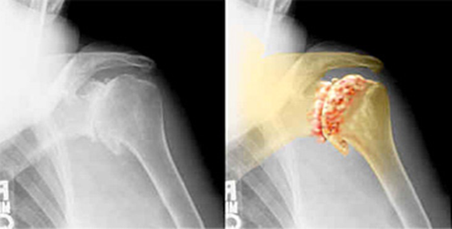
Case Study: Cancer Pain
63-year-old female with widespread pain as a result of lung cancer that had metastasized into her lymph nodes, vertebrae and the bones of her left shoulder. She was referred to the pain center by her oncologist to provide palliative pain relief.
CC: radicular low back pain r/t
lumbar mass pressing on the L5 nerve root,
focal left shoulder pain, nausea, constipation,
poor sleep, depression, extreme fatigue.

Slide 53
Her oncologist attempted to manage the pain by prescribing fentanyl
transdermal patch. However, even though the patient received relatively
high doses of the drug – each patch delivering 100 mcg over 72 hours –
minimal pain relief was achieved, dose limiting side effects.
Medications:
Gabapentin 100 mg tid.
Duragesic patch 100 mcg x3, q72hrs
Ambien 12.5mg qhs
Colace
Phenergan 25 mg qid prn
Zoloft 50 mg qd.

Slide 54
Medications:
Gabapentin 100 mg tid.
Duragesic patch 100 mcg x3, q72hrs
Ambien 12.5mg qhs
Colace
Phenergan 25 mg qid prn
Zoloft 50 mg qd.
How would you change her medications?
Are there any interventions that would be appropriate?
How would you apply an interdisciplinary approach to her pain
management?
What complementary therapies would be appropriate to
recommend?
What would you want to consider when recommending
Complementary therapies?

Slide 55
We discontinued the fentanyl transdermal patches and replaced them with 30 mg of orally administered methadone, taken three times daily. We were confident that the methadone in pill form would be tolerated because the patient was experiencing neither nausea nor vomiting.
The fentanyl transdermal patch did not help this patient because her body’s ability to absorb the medication was less than optimal. The degraded absorption capacity was due to the chemotherapy and radiation treatments she had undergone.
Second, we performed image-guided blockade injections of the suprascapular nerve and glenohumeral joint using a combination of bupivicaine and methylprednisolone acetate.

Slide 56
Fact/Myth
Barriers
Assessment
Education
Interventions
100 pt
100 pt
100 pt
100 pt
100 pt
200 pt
200 pt
200 pt
200 pt
200 pt
300 pt
300 pt
300 pt
300 pt
300 pt
400 pt
400 pt
400 pt
400 pt
400 pt
500 pt
500 pt
500 pt
500 pt
500 pt

Slide 57
Resources
PAIN SUPPORT GROUPS
American Chronic Pain Association 916-632-0922
P.O. Box 850, Rocklin, CA 95677 http://www.theacpa.org/
PAIN CLASSES
Stanford Pain Clinic 650-723-6238 (require a referral to Stanford Pain Clinic)
Stanford Center for Integrative Medicine 650-498-5566
For Those In Pain, Inc. 650-968-2323 http://www.forthoseinpain.org
PAIN/STRESS MANAGEMENT BOOKS
The Chronic Pain Solution – by Dillard
Feeling Good – by David Burns
Managing Pain Before it Manages You – by Caudill
Take Charge of Your Chronic Pain – by Peter Abaci
Full Catastrophe Living – by Jon Kabat-Zinn
Less Pain, Fewer Pills – by Beth Darnall
Low-Cost Acupuncture
http://www.osher.ucsf.edu/patient-care/treatments-services/acupuncture-and-traditional-chinese-medicine/
http://www.uewm.edu/

Slide 58
Resources
Pharmaceuticals
$4 Generic Medication Program
Walmart's complete medication list: http://i.walmartimages.com/i/if/hmp/fusion/customer_list.pdf
Target's competing, very similar program: http://www.target.com/pharmacy/generics-alphabetic
Patient financial assistance programs
http://www.pfizerhelpfulanswers.com/pages/Find/FindAll.aspx
https://www.celebrex.com/offers.aspx
http://coverageforall.org/pdf/FHCERxAssistanceProgramsGuide.pdf
https://www.rxhope.com/PAP/info/PAPList.aspx?drugid=4314&fieldT ype=drugid
http://www.allergan.com/responsibility/patient_resources/patient-assistance_programs.htm
http://www.patientassistance.com/profile/endopharmaceuticalsinc-135/

Slide 59
Resources
For People in Pain
Arthritis Foundation
American Cancer Society
American Chronic Pain Association
American Council for Headache Education
Cancer Care
The National Hospice and Palliative Care Organization
The Mayday Pain Project
The Vulvar Pain Foundation
National Fibromyalgia & Chronic Pain Association
National Headache Foundation
The TMJ Association
Information from the National Institutes of Health
National Institute on Neurological Disorders and Stroke
National Institute of Dental and Craniofacial Research (NIDCR)
National Institute of Arthritis and Musculoskeletal and Skin Diseases
National Cancer Institute (NCI)
National Center for Complementary and Alternative Medicine (NCCAM)

